Slide 1
UNIT 1
SOFTWARE ENGINEERING
Slide Set to accompany Software Engineering: A Practitioner’s Approach, 7/e
by Roger S. Pressman
Slides copyright © 1996, 2001, 2005, 2009 by Roger S. Pressman
For non-profit educational use only
May be reproduced ONLY for student use at the university level when used in conjunction with Software Engineering: A Practitioner's Approach, 7/e. Any other reproduction or use is prohibited without the express written permission of the author.
All copyright information MUST appear if these slides are posted on a website for student use.
These slides are designed to accompany Software Engineering: A Practitioner’s Approach, 7/e (McGraw-Hill, 2009). Slides copyright 2009 by Roger Pressman.

Slide 2
What is Software?
Software is: (1) instructions (computer programs) that when executed provide desired features, function, and performance; (2) data structures that enable the programs to adequately manipulate information and (3) documentation that describes the operation and use of the programs.
These slides are designed to accompany Software Engineering: A Practitioner’s Approach, 7/e (McGraw-Hill 2009). Slides copyright 2009 by Roger Pressman.

Slide 3
What is Software?
Software is developed or engineered, it is not manufactured in the classical sense.
Software doesn't "wear out."
Although the industry is moving toward component-based construction, most software continues to be custom-built.
These slides are designed to accompany Software Engineering: A Practitioner’s Approach, 7/e (McGraw-Hill 2009). Slides copyright 2009 by Roger Pressman.

Slide 4
Key aspects in software engineering
1. Requirement Analysis
2. Software Design
3. Software Development
4. Test and Integration
5. Deployment
6. Operationalization and Maintenance

Slide 5
1. Requirement Analysis
Stakeholder interaction
Requirement Elicitation
Requirement Documentation
Requirement Prioritization
Requirement Validation

Slide 6
Scope definition
Requirement traceability
Prototyping
Change management
Risk analysis

Slide 7
2. Software Design
Defining the architecture, components, modules and interfaces of the software system.
SRS is a reference for software developers to design best architecture for the software.
1. Architectural design
2. Interface design
3. Detailed design

Slide 8
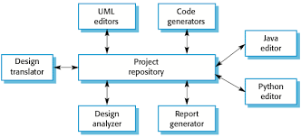
Architectural design

Slide 9
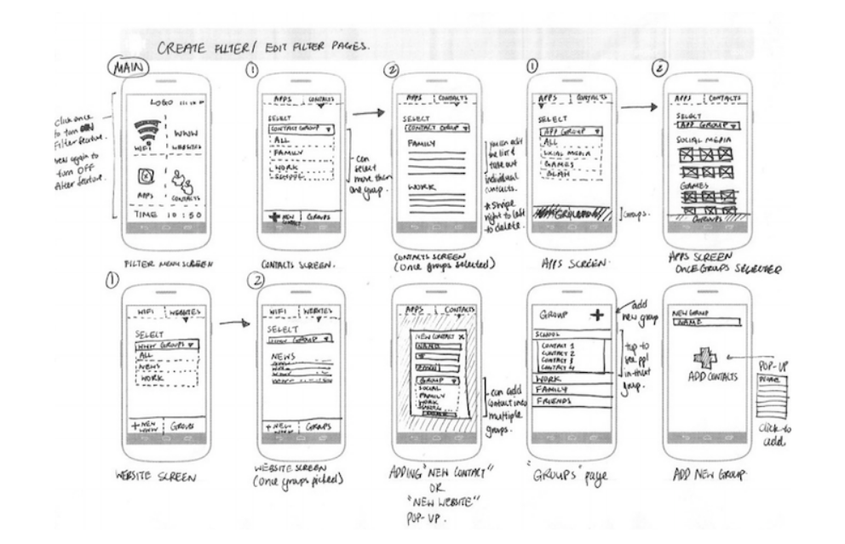
User interface design

Slide 10
DDS
Design document specification
Description of a software project in terms of architecture of software with various components with specified functionality.
Software engineer/designer or project manager can create DDS.

Slide 11
Contents in DDS
Reference documents
Modules of the product
Scope
Design description
Test Provisions
Packaging
File structures and global data
Requirement cross reference

Slide 12
Reference documents
Examples,
- Existing software documentation
- System documentation
- Vendor documents
- Technical reference

Slide 13
Scope
Hardware, Software and human interfaces
Major software functions.
Externally defined databases.

Slide 14
Importance of design documentation
Architecture/ design of the product
New person can also work for the project
Everything is well stated

Slide 15
3. Developing product/ Coding
Implementing product by using programming languages by following the protocols set by the team.

Slide 16
4. Testing and Integration
To ensure the smooth execution of the product.
Minimal testing in each phase.
Tracking all the probable flaws and fix them and retested.
Ensure the product meets the quality standards.

Slide 17
5. Deployment and maintenance
After detailed testing final product is released.
Testing in real industrial environment.
If performs well, organization deliver the product
After retrieving beneficial feedback,company releases it as it is or with auxiliary improvement to make it further helpful for the customers.

Slide 18
Software Applications
System software
Application software
Engineering/scientific software
Embedded software
Product-line software
WebApps (Web applications)
AI software
These slides are designed to accompany Software Engineering: A Practitioner’s Approach, 7/e (McGraw-Hill 2009). Slides copyright 2009 by Roger Pressman.

Slide 19
Software—New Categories
Open world computing—pervasive, distributed computing
Ubiquitous computing—wireless networks
Netsourcing—the Web as a computing engine
Open source—”free” source code open to the computing community (a blessing, but also a potential curse!)
Also … (see Chapter 31)
Data mining
Grid computing
Cognitive machines
Software for nanotechnologies
These slides are designed to accompany Software Engineering: A Practitioner’s Approach, 7/e (McGraw-Hill 2009). Slides copyright 2009 by Roger Pressman.

Slide 20
Legacy Software
Why must it change?
Software must be adapted to meet the needs of new computing environments or technology.
Software must be enhanced to implement new business requirements.
Software must be extended to make it interoperable with other more modern systems or databases.
Software must be re-architected to make it viable within a network environment.
These slides are designed to accompany Software Engineering: A Practitioner’s Approach, 7/e (McGraw-Hill 2009). Slides copyright 2009 by Roger Pressman.

Slide 21
Software crisis
Challenges and issues associated with developing, maintaining and managing software systems.
In early days of software engineering, projects exceeds their budgets and schedules.
Quality was major concern.
Same workforce, same methods, and same tools.
Rapidly increasing software demand, the complexity of software, and software challenges.

Slide 22
Structured programming, software engineering methodologies are the best practices to address these challenges.
Still faces issues like complexity, security vulnerabilities and changing requirements.

Slide 23
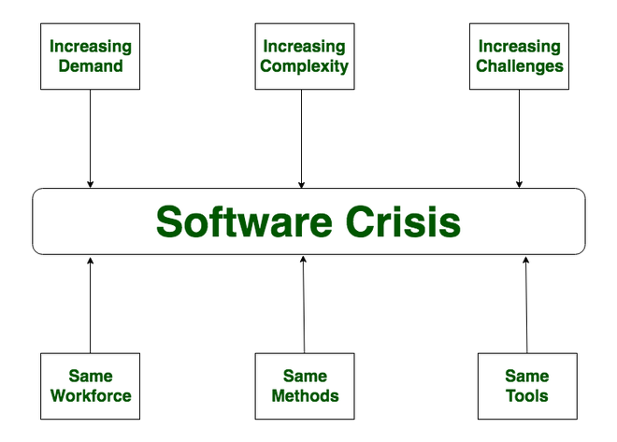

Slide 24
Causes of Software Crisis
The cost of owning and maintaining software was as expensive as developing the software.
At that time Projects were running overtime.
Software was very inefficient.
The quality of the software was low quality.
Software often did not meet user requirements.

Slide 25
The average software project overshoots its schedule by half.
Software was never delivered.
Non-optimal resource utilization.
Challenging to alter, debug, and enhance.

Slide 26
Poor project management.
Lack of adequate training in software engineering.
Less skilled project members.
Low productivity improvements.

Slide 27
Solution of Software Crisis
There is no single solution to the crisis.
One possible solution to software crisis is Software engineering.
1. Reduction in software over budget.
2. The quality of the software must be high.
3. Less time is needed for a software project.

Slide 28
4. Experienced and skilled people working on the project.
5. Software must be delivered.
6. Software must meet user requirements.

Slide 29
A Layered Technology
tools
methods
process
a “quality” focus
Software Engineering

Slide 30
Quality focus
- Bedrock that supports software engineering.
- Continuous process improvement principles of software.
Process
1. Basis for management control of software projects.
2. Establishes context in which technical methods are applied.
3. Work products are produced
4. Milestones are established
5. Change is properly managed
These slides are designed to accompany Software Engineering: A Practitioner’s Approach, 7/e (McGraw-Hill 2009). Slides copyright 2009 by Roger Pressman.

Slide 31
Methods
Technical how to do’s for building software
1. Communication
2. Requirement analysis
3. Design modelling
4. Program construction
5. Testing and support
These slides are designed to accompany Software Engineering: A Practitioner’s Approach, 7/e (McGraw-Hill 2009). Slides copyright 2009 by Roger Pressman.

Slide 32
Tools
Automated or semi automated support for the process and methods.
These slides are designed to accompany Software Engineering: A Practitioner’s Approach, 7/e (McGraw-Hill 2009). Slides copyright 2009 by Roger Pressman.

Slide 33
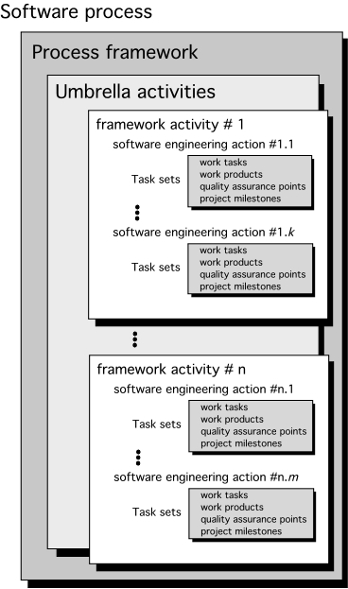
A Generic Process Model
These slides are designed to accompany Software Engineering: A Practitioner’s Approach, 7/e (McGraw-Hill, 2009). Slides copyright 2009 by Roger Pressman.

Slide 34
Process framework establishes foundation for a complete SE process.
- Framework activities
- Umbrella activities
These slides are designed to accompany Software Engineering: A Practitioner’s Approach, 7/e (McGraw-Hill, 2009). Slides copyright 2009 by Roger Pressman.

Slide 35
Framework activities
Communication
Planning
Modeling
Construction
Deployment
These slides are designed to accompany Software Engineering: A Practitioner’s Approach, 7/e (McGraw-Hill, 2009). Slides copyright 2009 by Roger Pressman.

Slide 36
Umbrella Activities
Software project tracking and control
Risk management
Software quality assurance
Technical reviews
Software configuration management
Reusability management
Work project preparation and production
These slides are designed to accompany Software Engineering: A Practitioner’s Approach, 7/e (McGraw-Hill, 2009). Slides copyright 2009 by Roger Pressman.

Slide 37
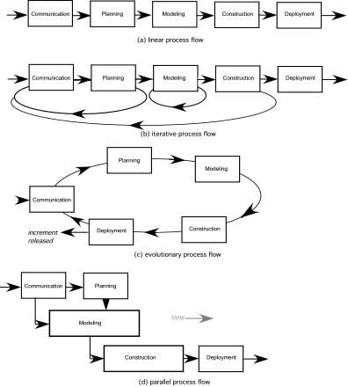
Process Flow
These slides are designed to accompany Software Engineering: A Practitioner’s Approach, 7/e (McGraw-Hill, 2009). Slides copyright 2009 by Roger Pressman.

Slide 38
Process Assessment and Improvement
Standard CMMI Assessment Method for Process Improvement (SCAMPI) — provides a five step process assessment model that incorporates five phases: initiating, diagnosing, establishing, acting and learning.
CMM-Based Appraisal for Internal Process Improvement (CBA IPI)—provides a diagnostic technique for assessing the relative maturity of a software organization; uses the SEI CMM as the basis for the assessment [Dun01]
SPICE—The SPICE (ISO/IEC15504) standard defines a set of requirements for software process assessment. The intent of the standard is to assist organizations in developing an objective evaluation of the efficacy of any defined software process. [ISO08]
ISO 9001:2000 for Software—a generic standard that applies to any organization that wants to improve the overall quality of the products, systems, or services that it provides. Therefore, the standard is directly applicable to software organizations and companies. [Ant06]
These slides are designed to accompany Software Engineering: A Practitioner’s Approach, 7/e (McGraw-Hill, 2009). Slides copyright 2009 by Roger Pressman.

Slide 39
Prescriptive Models
Prescriptive process models advocate an orderly approach to software engineering
That leads to a few questions …
If prescriptive process models strive for structure and order, are they inappropriate for a software world that thrives on change?
Yet, if we reject traditional process models (and the order they imply) and replace them with something less structured, do we make it impossible to achieve coordination and coherence in software work?
These slides are designed to accompany Software Engineering: A Practitioner’s Approach, 7/e (McGraw-Hill, 2009). Slides copyright 2009 by Roger Pressman.

Slide 40
Prescriptive software models are those which prescribe the components which make up a software model.
including the activities, the inputs and outputs of the activities, how quality assurance is performed, how change is managed.
representation of the order of activities of the process and the sequence in which they are performed.
These slides are designed to accompany Software Engineering: A Practitioner’s Approach, 7/e (McGraw-Hill, 2009). Slides copyright 2009 by Roger Pressman.

Slide 41
A model will define the following:
The tasks to be performed
The input and output of each task
The pre and post-conditions for each task
The flow and sequence of each task
These slides are designed to accompany Software Engineering: A Practitioner’s Approach, 7/e (McGraw-Hill, 2009). Slides copyright 2009 by Roger Pressman.

Slide 42
The goal of a software process model is to provide guidance for controlling and coordinating the tasks to achieve the end product and objectives as effectively as possible.
These slides are designed to accompany Software Engineering: A Practitioner’s Approach, 7/e (McGraw-Hill, 2009). Slides copyright 2009 by Roger Pressman.

Slide 43
SDLC models
SDLC models (Software Development Life Cycle models)
Waterfall model
V model
Incremental model
Spiral model
These slides are designed to accompany Software Engineering: A Practitioner’s Approach, 7/e (McGraw-Hill, 2009). Slides copyright 2009 by Roger Pressman.

Slide 44
Factors in choosing a software process
1. Project requirements
2. Project size
3. Project complexity
4. Cost of delay
5. Customer involvement
6. Project resources
These slides are designed to accompany Software Engineering: A Practitioner’s Approach, 7/e (McGraw-Hill, 2009). Slides copyright 2009 by Roger Pressman.

Slide 45
1. Waterfall model
The waterfall model is a sequential, plan driven-process.
Plan and schedule all the activities before starting the project.
Each activity in the waterfall model is represented as a separate phase arranged in linear order.
These slides are designed to accompany Software Engineering: A Practitioner’s Approach, 7/e (McGraw-Hill, 2009). Slides copyright 2009 by Roger Pressman.

Slide 46
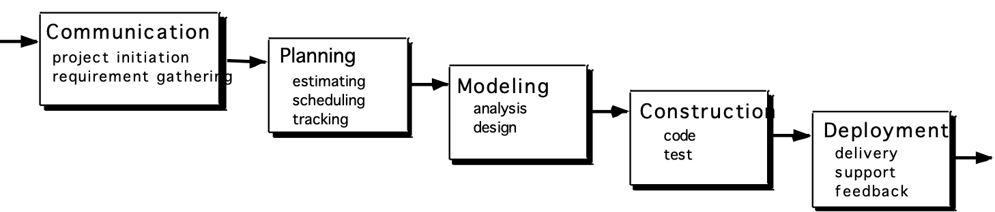
The Waterfall Model
These slides are designed to accompany Software Engineering: A Practitioner’s Approach, 7/e (McGraw-Hill, 2009). Slides copyright 2009 by Roger Pressman.

Slide 47
V Model
The V model (Verification and Validation model) is an extension of the waterfall model.
All the requirements are gathered at the start and cannot be changed.
These slides are designed to accompany Software Engineering: A Practitioner’s Approach, 7/e (McGraw-Hill, 2009). Slides copyright 2009 by Roger Pressman.

Slide 48
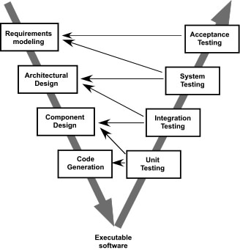
The V-Model
These slides are designed to accompany Software Engineering: A Practitioner’s Approach, 7/e (McGraw-Hill, 2009). Slides copyright 2009 by Roger Pressman.

Slide 49
The Incremental Model
The incremental model divides the system’s functionality into small increments that are delivered one after the other in quick succession.
The incremental model lets stakeholders and developers see results with the first increment.
It is efficient as the developers only focus on what is important and bugs are fixed as they arise.
Need a clear and complete definition of the whole system before start developing the model.
These slides are designed to accompany Software Engineering: A Practitioner’s Approach, 7/e (McGraw-Hill, 2009). Slides copyright 2009 by Roger Pressman.

Slide 50
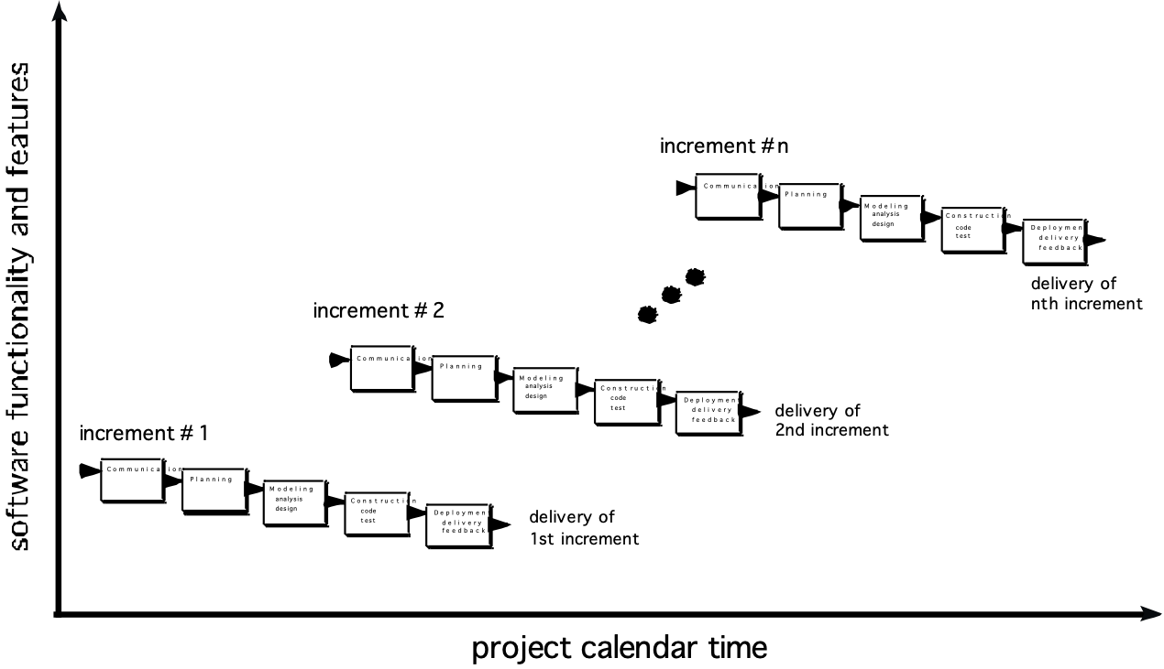
The Incremental Model
These slides are designed to accompany Software Engineering: A Practitioner’s Approach, 7/e (McGraw-Hill, 2009). Slides copyright 2009 by Roger Pressman.

Slide 51
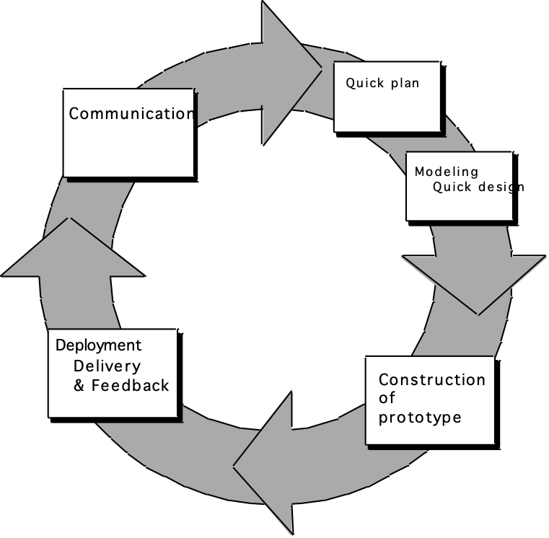
Evolutionary Models: Prototyping
Quick
plan
communication
Modeling
Quick design
Deployment
delivery &
feedback
Construction
of prototype
Construction
of prototype
These slides are designed to accompany Software Engineering: A Practitioner’s Approach, 7/e (McGraw-Hill, 2009). Slides copyright 2009 by Roger Pressman.

Slide 52
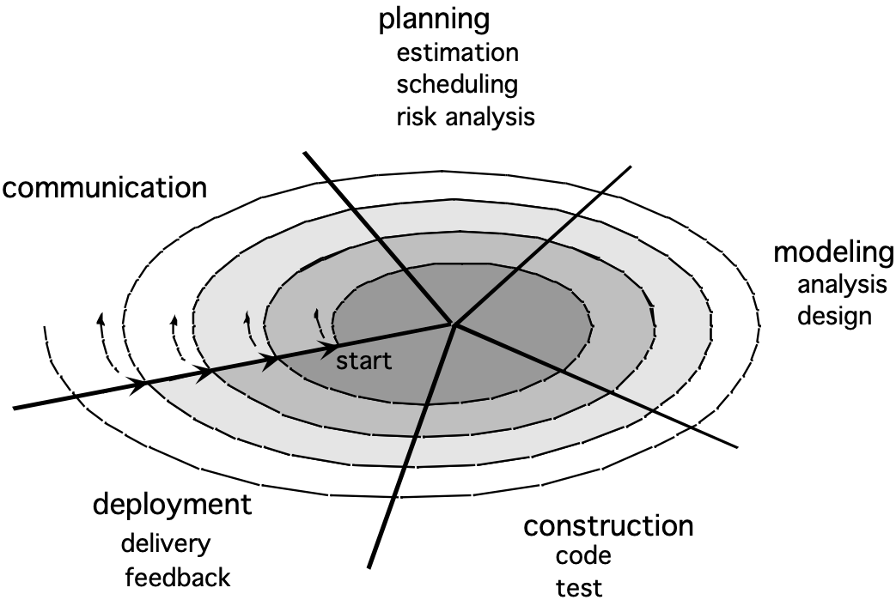


Evolutionary Models: The Spiral
These slides are designed to accompany Software Engineering: A Practitioner’s Approach, 7/e (McGraw-Hill, 2009). Slides copyright 2009 by Roger Pressman.

Slide 53
The Manifesto for Agile Software Development
“We are uncovering better ways of developing software by doing it and helping others do it. Through this work we have come to value:
Individuals and interactions over processes and tools
Working software over comprehensive documentation
Customer collaboration over contract negotiation
Responding to change over following a plan
That is, while there is value in the items on the right, we value the items on the left more.”
Kent Beck et al
These slides are designed to accompany Software Engineering: A Practitioner’s Approach, 7/e (McGraw-Hill, 2009) Slides copyright 2009 by Roger Pressman.

Slide 54
What is “Agility”?
Effective (rapid and adaptive) response to change.
Effective communication among all stakeholders
Drawing the customer onto the team
Organizing a team so that it is in control of the work performed
Yielding …
Rapid, incremental delivery of software
These slides are designed to accompany Software Engineering: A Practitioner’s Approach, 7/e (McGraw-Hill, 2009) Slides copyright 2009 by Roger Pressman.

Slide 55
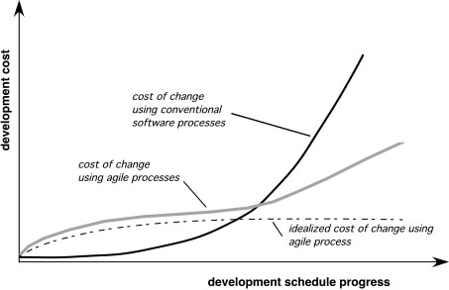
Agility and the Cost of Change
These slides are designed to accompany Software Engineering: A Practitioner’s Approach, 7/e (McGraw-Hill, 2009) Slides copyright 2009 by Roger Pressman.

Slide 56
An Agile Process
Is driven by customer descriptions of what is required (scenarios)
Recognizes that plans are short-lived
Develops software iteratively with a heavy emphasis on construction activities
Delivers multiple ‘software increments’
Adapts as changes occur
These slides are designed to accompany Software Engineering: A Practitioner’s Approach, 7/e (McGraw-Hill, 2009) Slides copyright 2009 by Roger Pressman.

Slide 57
Agility Principles - I
1. Our highest priority is to satisfy the customer through early and continuous delivery of valuable software.
2. Welcome changing requirements, even late in development. Agile processes harness change for the customer's competitive advantage.
3. Deliver working software frequently, from a couple of weeks to a couple of months, with a preference to the shorter timescale.
4. Business people and developers must work together daily throughout the project.
5. Build projects around motivated individuals. Give them the environment and support they need, and trust them to get the job done.
6. The most efficient and effective method of conveying information to and within a development team is face–to–face conversation.
These slides are designed to accompany Software Engineering: A Practitioner’s Approach, 7/e (McGraw-Hill, 2009) Slides copyright 2009 by Roger Pressman.

Slide 58
Agility Principles - II
7. Working software is the primary measure of progress.
8. Agile processes promote sustainable development. The sponsors, developers, and users should be able to maintain a constant pace indefinitely.
9. Continuous attention to technical excellence and good design enhances agility.
10. Simplicity – the art of maximizing the amount of work not done – is essential.
11. The best architectures, requirements, and designs emerge from self–organizing teams.
12. At regular intervals, the team reflects on how to become more effective, then tunes and adjusts its behavior accordingly.
These slides are designed to accompany Software Engineering: A Practitioner’s Approach, 7/e (McGraw-Hill, 2009) Slides copyright 2009 by Roger Pressman.

Slide 59
Human Factors
the process molds to the needs of the people and team, not the other way around
key traits must exist among the people on an agile team and the team itself:
Competence.
Common focus.
Collaboration.
Decision-making ability.
Fuzzy problem-solving ability.
Mutual trust and respect.
Self-organization.
These slides are designed to accompany Software Engineering: A Practitioner’s Approach, 7/e (McGraw-Hill, 2009) Slides copyright 2009 by Roger Pressman.

Slide 60
Extreme Programming (XP)
The most widely used agile process, originally proposed by Kent Beck
XP Planning
Begins with the creation of “user stories”
Agile team assesses each story and assigns a cost.
Stories are grouped for a deliverable increment
A commitment is made on delivery date
After the first increment “project velocity” is used to help define subsequent delivery dates for other increments.
These slides are designed to accompany Software Engineering: A Practitioner’s Approach, 7/e (McGraw-Hill, 2009) Slides copyright 2009 by Roger Pressman.

Slide 61
Extreme Programming (XP)
XP Design
Follows the KIS principle
Encourage the use of CRC cards.
For difficult design problems, suggests the creation of “spike solutions”—a design prototype
Encourages “refactoring”—an iterative refinement of the internal program design
XP Coding
Recommends the construction of a unit test for a story before coding commences
Encourages “pair programming”
XP Testing
All unit tests are executed daily
“Acceptance tests” are defined by the customer and executed to assess customer visible functionality
These slides are designed to accompany Software Engineering: A Practitioner’s Approach, 7/e (McGraw-Hill, 2009) Slides copyright 2009 by Roger Pressman.

Slide 62
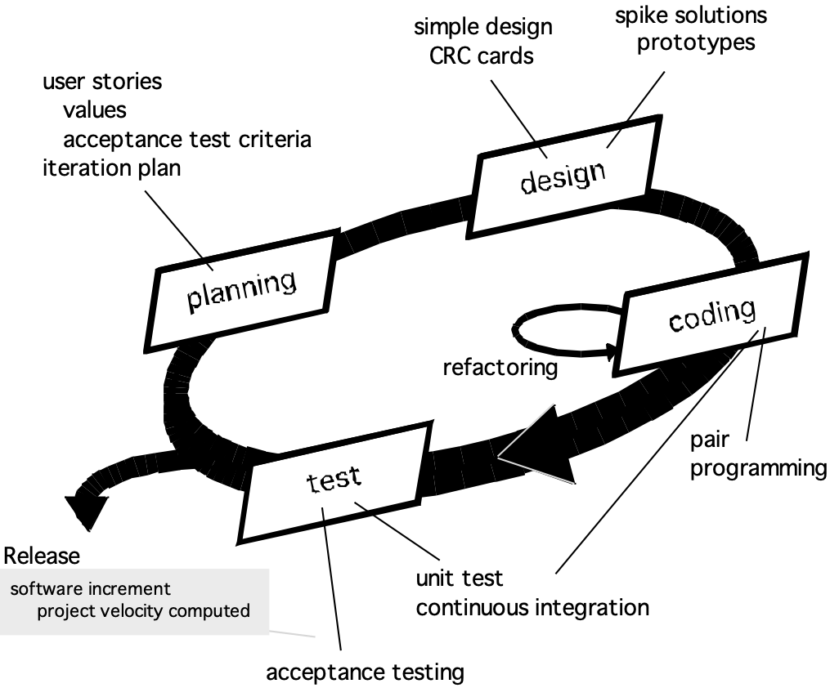
Extreme Programming (XP)
These slides are designed to accompany Software Engineering: A Practitioner’s Approach, 7/e (McGraw-Hill, 2009) Slides copyright 2009 by Roger Pressman.

Slide 63
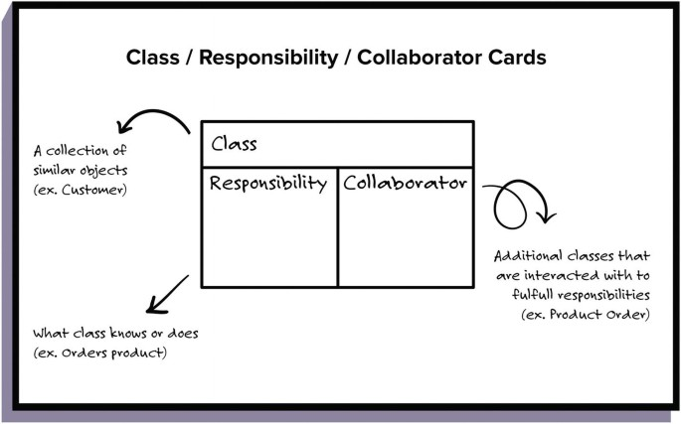
CRC Cards
These slides are designed to accompany Software Engineering: A Practitioner’s Approach, 7/e (McGraw-Hill, 2009) Slides copyright 2009 by Roger Pressman.

Slide 64
Scrum
Originally proposed by Schwaber and Beedle
Scrum—distinguishing features
Development work is partitioned into “packets”
Testing and documentation are on-going as the product is constructed
Work occurs in “sprints” and is derived from a “backlog” of existing requirements
Meetings are very short and sometimes conducted without chairs
“demos” are delivered to the customer with the time-box allocated
These slides are designed to accompany Software Engineering: A Practitioner’s Approach, 7/e (McGraw-Hill, 2009) Slides copyright 2009 by Roger Pressman.

Slide 65
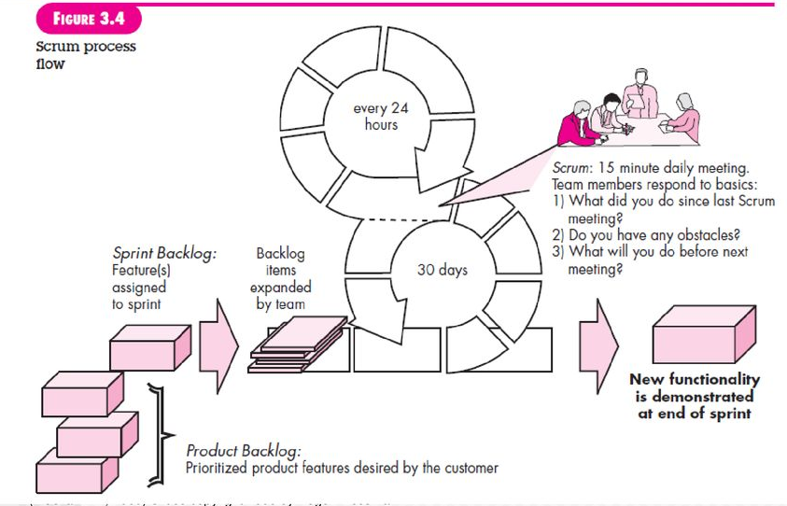
Scrum
These slides are designed to accompany Software Engineering: A Practitioner’s Approach, 7/e (McGraw-Hill, 2009) Slides copyright 2009 by Roger Pressman.

Slide 66
Backlog: Prioritized list of project requirements or features that provide business value for the customer. Items can be added to backlog at any time.
Sprint: Work units that are required to achieve a requirement defined in a backlog that must be fit into a predefined time box.
A Sprint is a time box of one month or less. A
new Sprint starts immediately after the
completion of the previous Sprint.
These slides are designed to accompany Software Engineering: A Practitioner’s Approach, 7/e (McGraw-Hill, 2009) Slides copyright 2009 by Roger Pressman.

Slide 67
Scrum meeting: short meeting held daily by the scrum team.(typically 15 minutes).
1. What did you do since the last team meeting?
2. What obstacles are you encountering?
3. What do you plan to accomplish by the next team meeting?
Scrum master is responsible for scheduling team meetings and assesses the responses from each persons.
Release: When the product is completed, it goes to the Release stage.
These slides are designed to accompany Software Engineering: A Practitioner’s Approach, 7/e (McGraw-Hill, 2009) Slides copyright 2009 by Roger Pressman.

